Slide 1
DEPi
Real estate
.NET Developent project

Slide 2
01
02
Table of contents
04
Objectives
Introduction
Overview
Key Informations about the Application
Objective and Scope
Key Features
Objectives and Goals of
the Real Estate Property Management
Final Project
Archeticture
User interface
system Layers and functionality
preview of the application
screens
Future Enhancements
Closing Thoughts

Slide 3
Introduction

Slide 4

pahses
Phase 1
Phase 2
Setup and Property Management
Tenant Management and Lease Agreements

Slide 5
Phase 3
phase 4
Rent Payments and Reporting
Final Testing, UI Enhancements, and Deployment

Slide 6
Overview
Property & Tenant Management
Allows property managers to easily add, update, and manage property details, tenant information, and lease agreements, simplifying day-to-day administrative tasks.
Rent Payments & Financial
Tenants can make online rent payments, while property managers can track payment history, generate financial reports, and gain insights into outstanding payments.
User Authentication & Role-Based Access
Secure login system with role-based access control, ensuring that property managers and tenants have different permissions based on their roles, enhancing security and operational clarity.

Slide 7
Problem statement
Inefficient Property & Tenant Management
Difficulty in keeping track of multiple properties, tenant details, lease terms, and occupancy statuses, often resulting in missed deadlines or incomplete records.
Manual Rent Payment Processing
Collecting rent manually can lead to delayed payments, difficulty in tracking payment history, and issues with accountability for both tenants and property managers.
Key challenges faced by property managers and tenants include:
Property and Project Development
difficulty in accurately tracking property maintenance and compliance with regulations throughout the project lifecycle. Without a centralized system, developers may struggle to manage inspections

Slide 8
Objectives and Goals of
the Real Estate Property Management

Slide 9
Objectives and Goals
Streamlined Property Management
Implement a user-friendly interface for property managers to efficiently manage property listings, tenant information, and lease agreements. This aims to reduce administrative overhead and enhance operational efficiency.
Tenant Empowerment
Provide tenants with self-service capabilities to view lease details, submit maintenance requests, and make online rent payments. This objective focuses on improving tenant satisfaction and engagement through better accessibility

Slide 10
Goals
Role-Based Access Control
Establish a secure user authentication system that differentiates access levels between property managers and tenants. This objective ensures data integrity and protects sensitive information while allowing users to access relevant functionalities
DAY Efficient Lease Management
Implement features for creating, editing, and terminating lease agreements with ease. This goal aims to streamline lease management processes, ensuring timely renewals and reducing administrative burdens.

Slide 11

Project Scope and Requirements

Slide 12
Functional Requirements:
User Management
Admins manage properties, property managers handle assigned properties, and users access listing
Property Management Module
allow property managers to add, update, and delete property listings, including details such as location, size, amenities, and pricing. Users should be able to view property details and search/filter listings based on specific criteria
Lease Agreement Management
should track key lease details such as start and end dates, payment terms, and any special conditions.

Slide 13
Functional Requirements:
Document Management
support uploading and managing important documents related to properties and leases, such as contracts, inspection reports, and correspondence. Users should be able to easily access, download these documents.
Automated Payment Generation:
generate upcoming payment records based on established lease agreements.
scheduled payments are created without manual intervention, reducing errors and ensuring that both tenants and property managers are consistently informed

Slide 14
Target users or beneficiaries
Property Managers:
benefit from streamlined
management of listings, tenants, lease agreements.
Tenants:
They will have easy access to view lease details, make rent payments, and report issues.
Real Estate Agencies:
Agencies will gain improved efficiency in tracking tenant information and payments.

Slide 15
System Architecture/Design

Slide 16
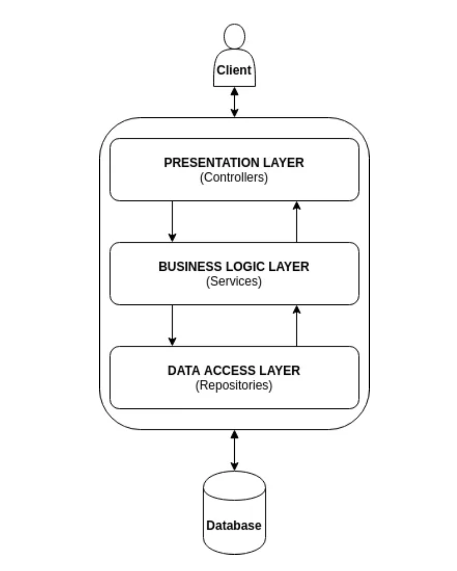
Presentation Layer
Controllers
Data Access Layer (DataAccessLayer project):
Handle user requests and manage the flow of data between the view and the business layer.
Views
Service Layer
Render the user interface using Razor syntax.
Offer a service-based interface for external systems or components
DTOs (Data Transfer Objects): Used for data exchange between layers.
Models: Represent the data structures used in views.

Slide 17

Technology stack
3. SQL Server
relational database for storing and managing property and tenant data.
Short terms
4. HTML/CSS/JavaScrip/ Bootstrap
5. Identity Framework
1. ASP.NET Core
6.RESTful API
Robust framework for building web Apps.
For enabling communication between the front-end and back-end services, allowing for seamless data retrieval and manipulation.
2. Entity Framework
An (ORM) that simplifies database interactions and migrations.

Slide 18
Data Flow
1 User Interaction:
Users interact with the web application through the UI to manage properties, leases, and payments.
2 Request Handling:
User actions trigger HTTP requests, rocessed by the ASP.NET Core controllers, routing them to the appropriate service.
3 Database Operations
Entity Framework interacts with SQL Server, executing CRUD operations .
4 Response and Display
Data is fetched or modified, processed by the application, and sent back to the UI to display the updated information or feedback to the user.

Slide 19
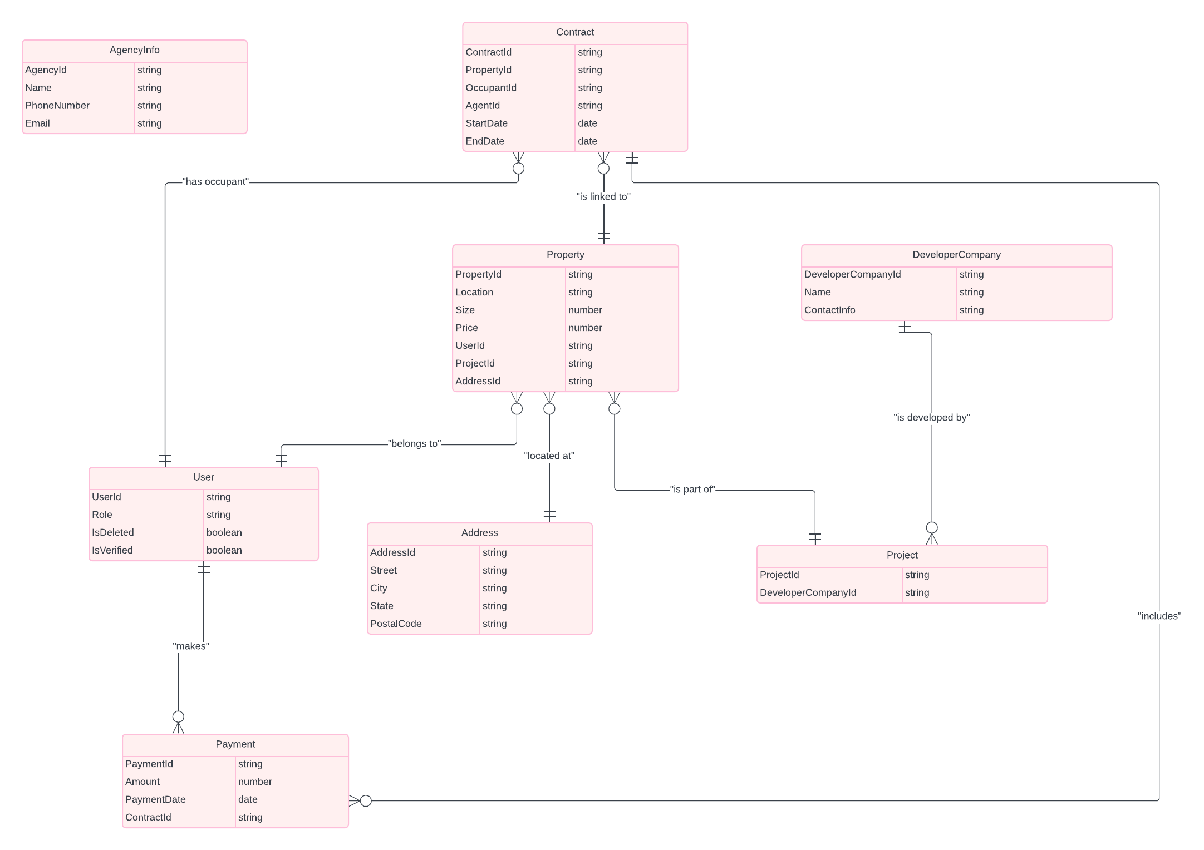
entity relationships

Slide 20
user interface

Slide 21
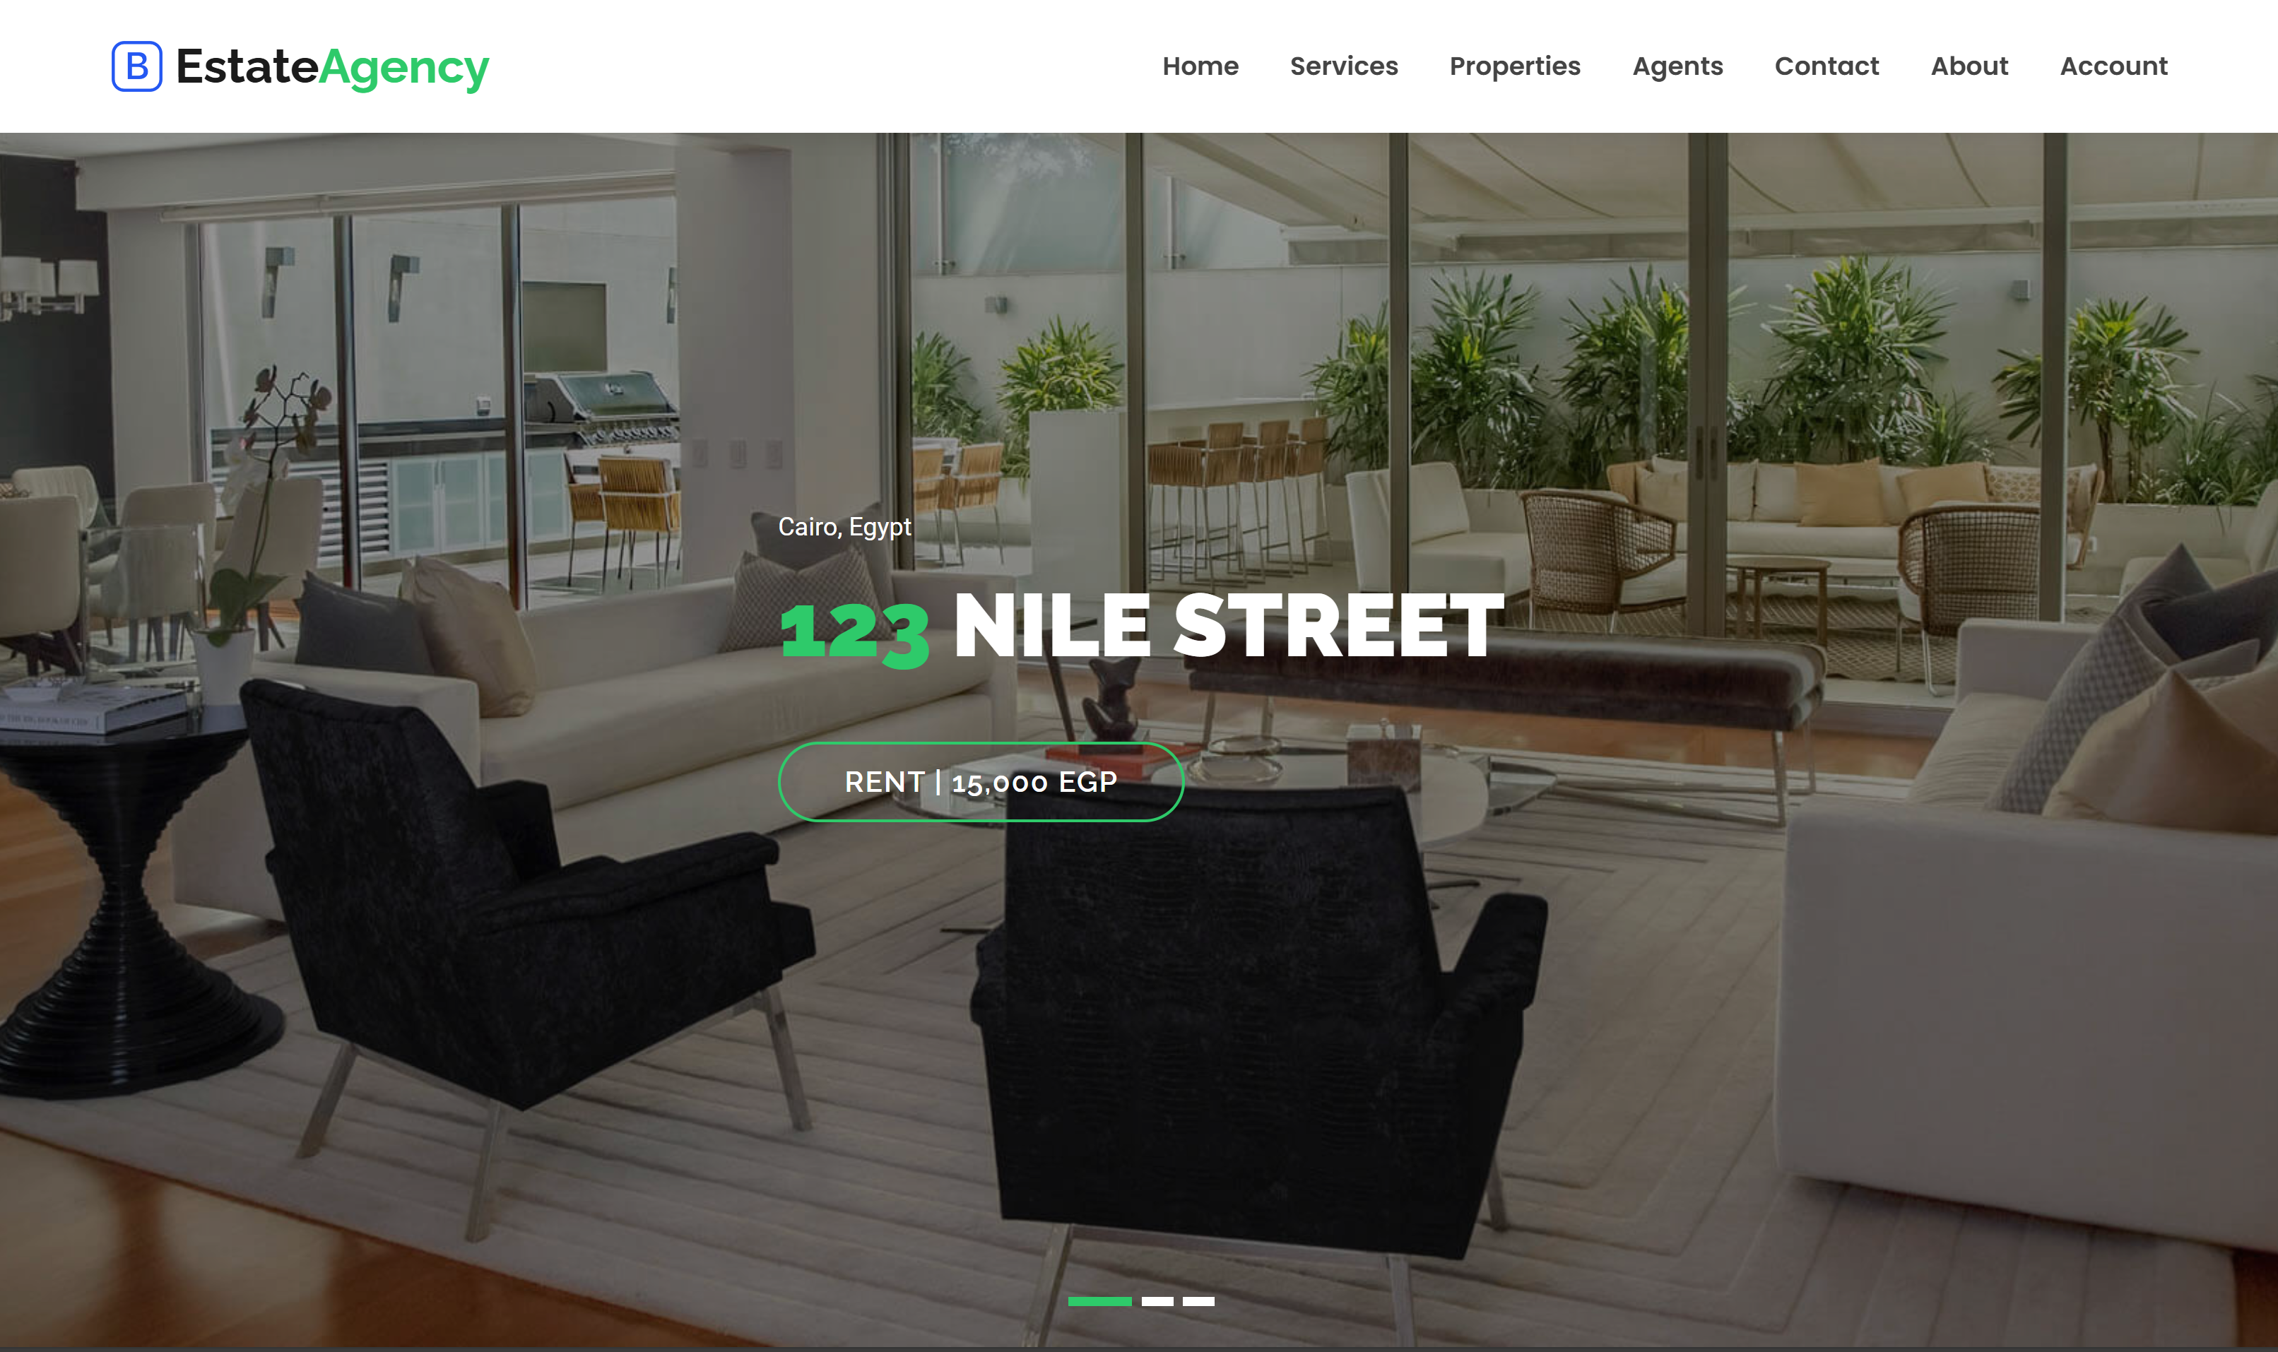
Home

Slide 22
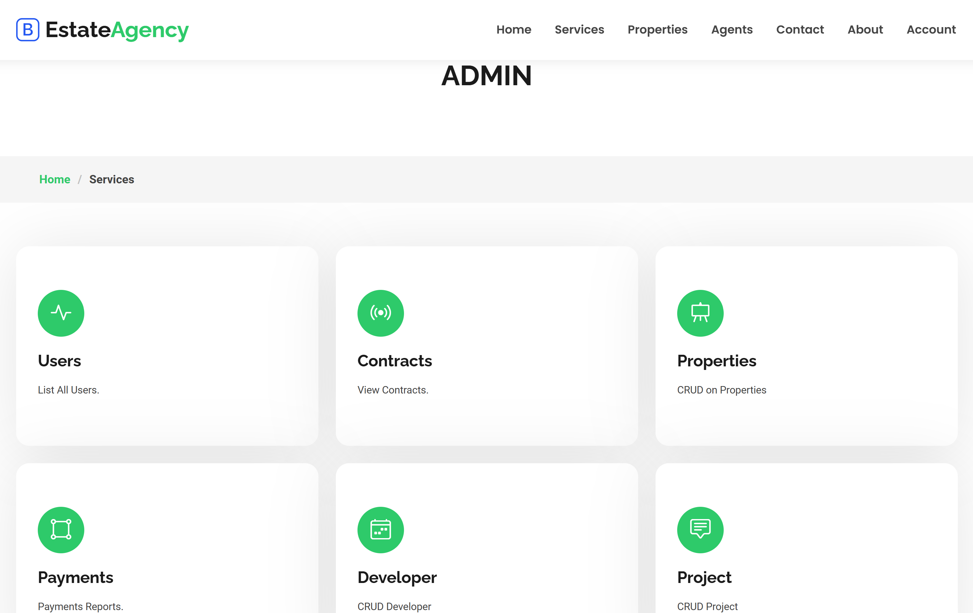
Admin interface

Slide 23
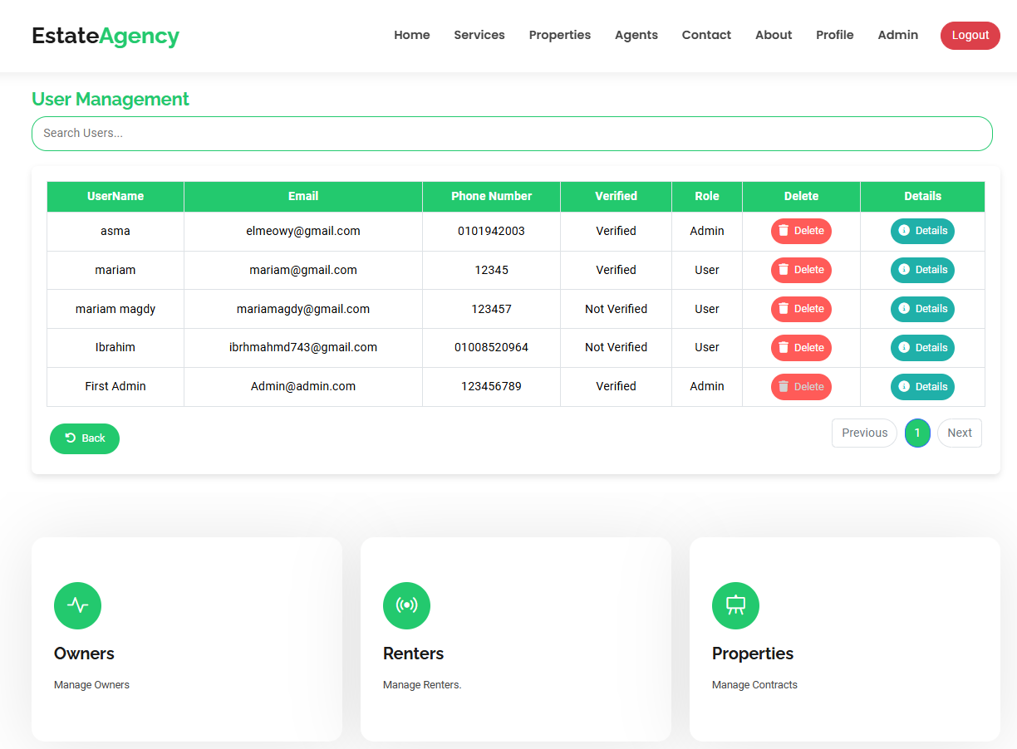
User
Managment

Slide 24
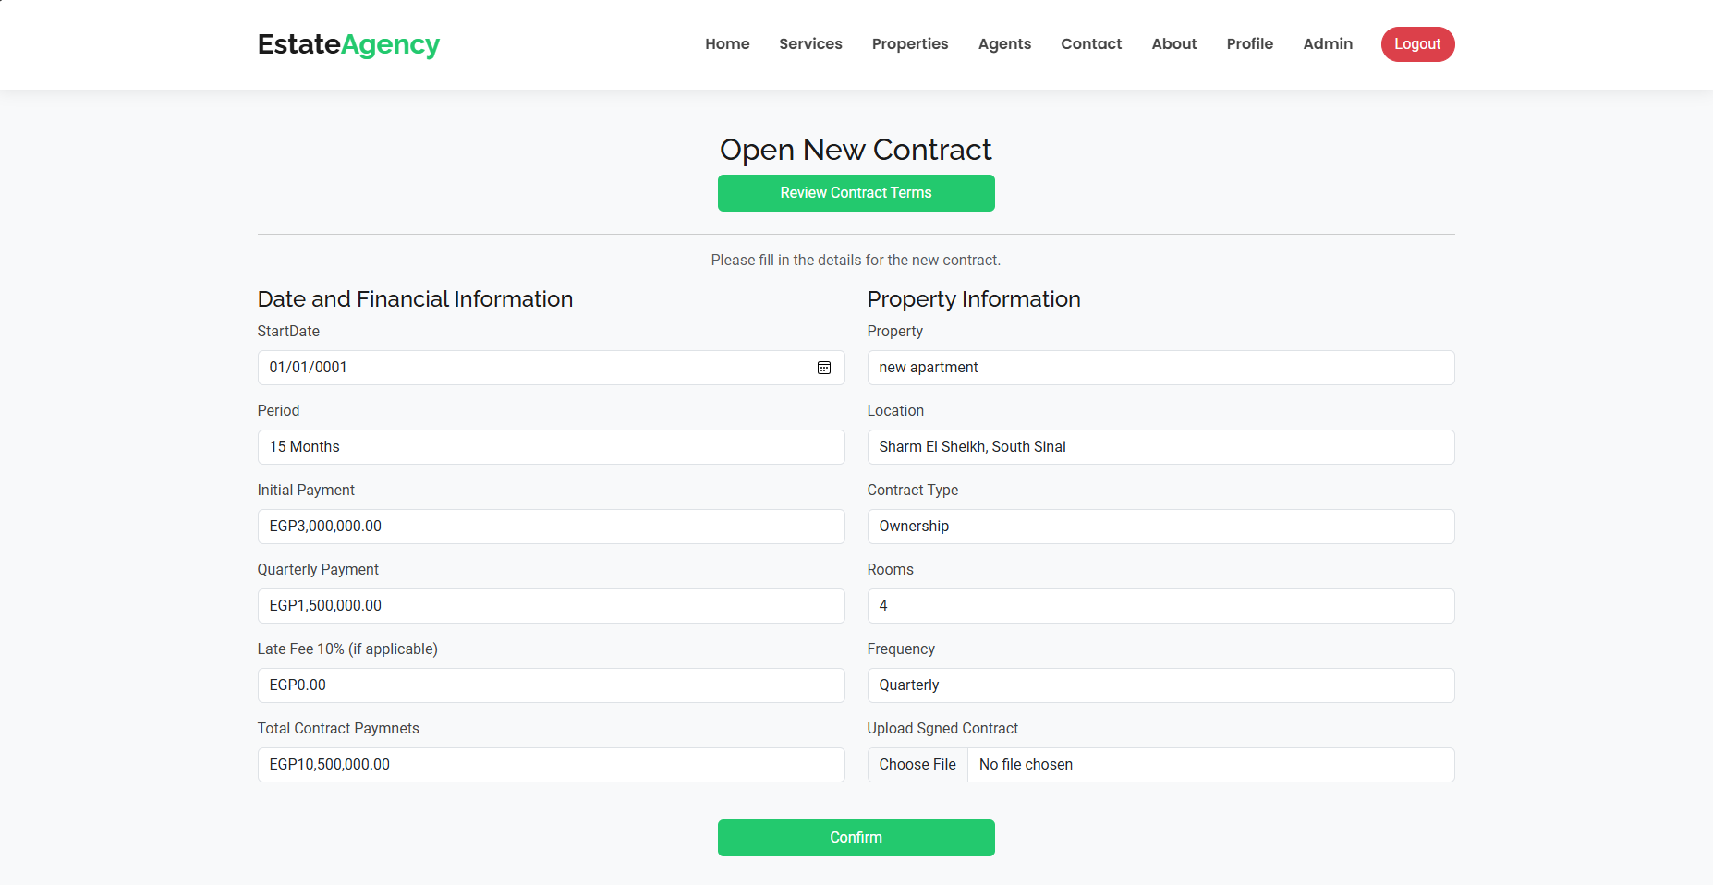
create Contract

Slide 25
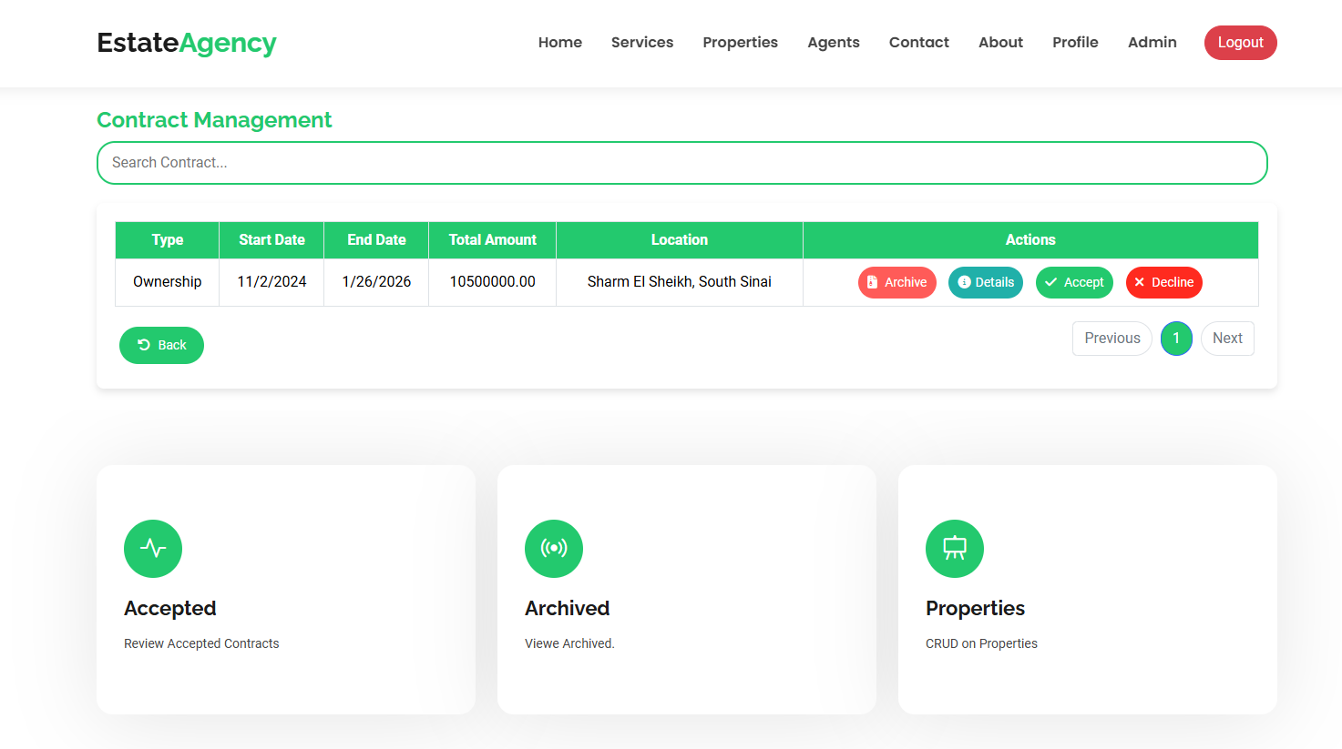
contract managment

Slide 26
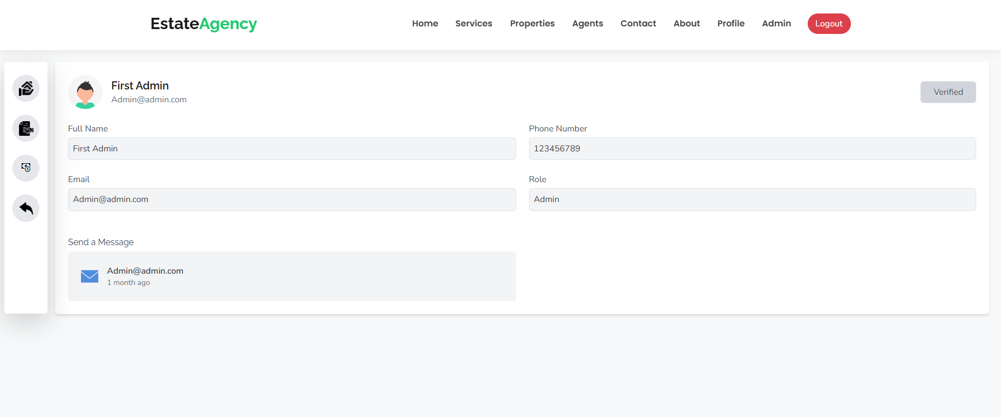
User profile

Slide 27
CONCLUSION

Slide 28

Future Work/Improvements
Future Enhancements
Additional integrations
Next Steps
automation features, automatic reminders for Users about upcoming payments or lease expirations
services like payment gateways or property listing platforms.
Focus on gathering user feedback from beta testing to fine-tune existing functionalities.
Areas for Expansion
mobile app version
advanced data analytics
managers and tenants more flexibility in managing properties and payments on the gp
support multiple languages and currencies to accommodate a global user base
providing insights into rent collection trends, occupancy rates, and financial forecasts.

Slide 29
Final Remarks
Summary
- Developed a complete Real Estate Property Management System with property, tenant, contract, and payment features.
- Integrated role-based user authentication for secure, personalized access.
- A modern solution for real estate management that saves time and boosts productivity.
- Future enhancements like mobile support and analytics will ensure ongoing growth.
- Thank you—excited for the system's continued development!
Reflection on Impact
- Streamlined property management and automated key processes, improving efficiency.
-Simplified tenant experience with easy access to lease info, payments, and issue reporting.

Slide 30
Thanks
IBRAHIM AHMED
MARIAM MAGDY
MOHAMED SABER
MOHAMED GALLOW
AHMED ELSHIEKH

